Slide 1


August 25 Update

Slide 2
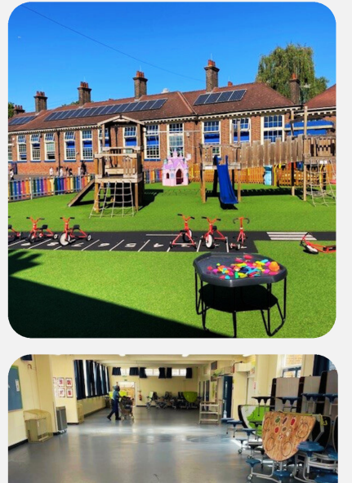
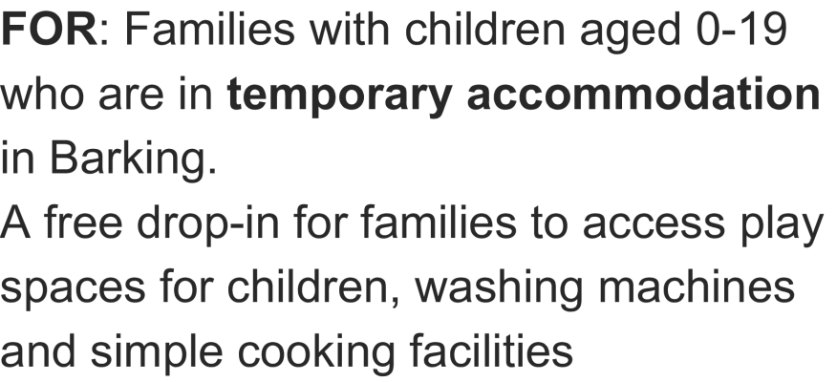


Slide 3
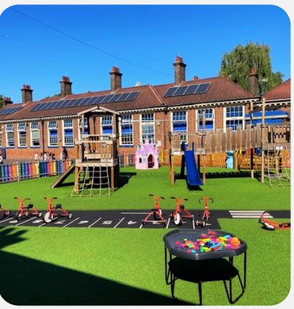
Next Steps
Focussed promotion to families in hotels and raise awareness for hotel managers of the provision
Link up with LBBD Cooking clubs funded through Household Support Fund (HSF)
Review provision with families to identify any changes needed
Plan for winter when outside space may be less accessible

